Slide 1




Collaborative
Filtering
Group3
Wanting Cui(wc2619) Peifeng Hong(ph2534) Wenshan Wang(ww2468) Fan Yan(fy2232) Sitong Chen(sc4283)

Slide 2
Outline
Overview
Parameter
Evaluation
Next Steps

Slide 3
Overview
Technique used by recommender systems -- by wiki
Why? To reduce information overload
Make a quick and effective prediction

Slide 4
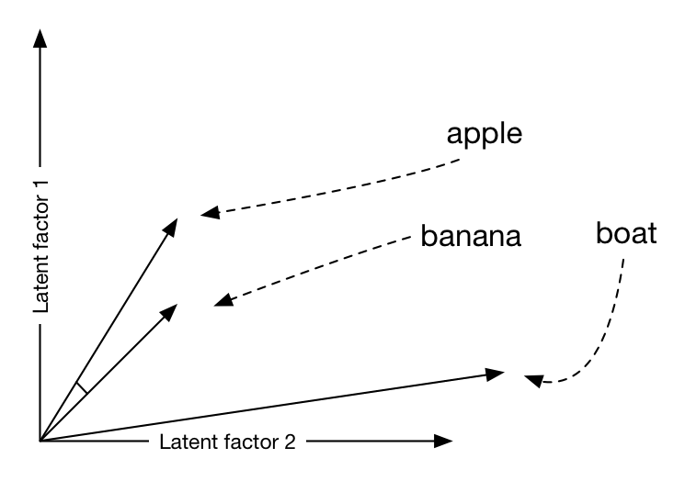
Memory-based Algorithms
Compute Similarity (weight)
Vector Similarity
The cosine of two vectors in the high-dimension space

Slide 5
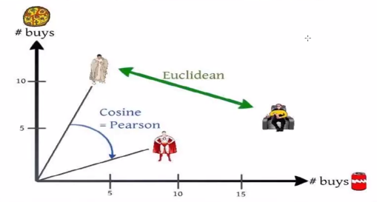
Memory-based Algorithms
Compute Similarity (weight)
Mean difference error
The Euclidean distance of two vectors in the high-dimension space

Slide 6
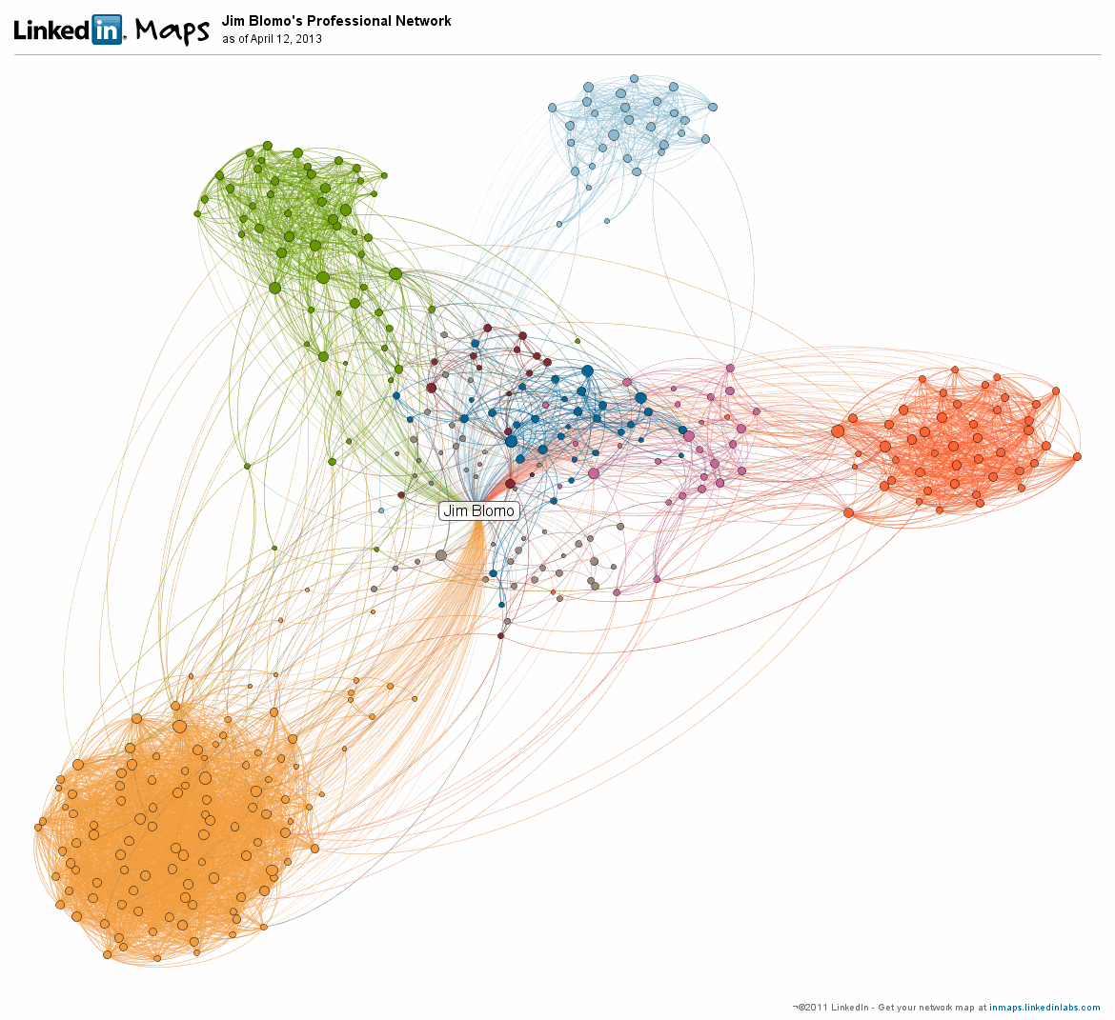
Memory-based Algorithms
Compute Similarity (weight)
Simrank
Using the similarity of in-neighbor and out-neighbor to evaluate the similarity of user.If the users have similar votes, they will be regarded as same kind of people. And the similarity of items is used.

Slide 7
Memory-based Algorithms
Compute Similarity (weight)

Slide 8
Memory-based Algorithms
Selecting Neighbor
Bestn & threshold & combined
Bestn method uses a certain amount of user to make prediction
Threshld method set a bound for the similarity weight

Slide 9
Model-based Algorithms
Cluster Model
Assume a certain type of users
Each type of user has a certain preference on the movie and give similar vote
Using EM algorithm

Slide 10
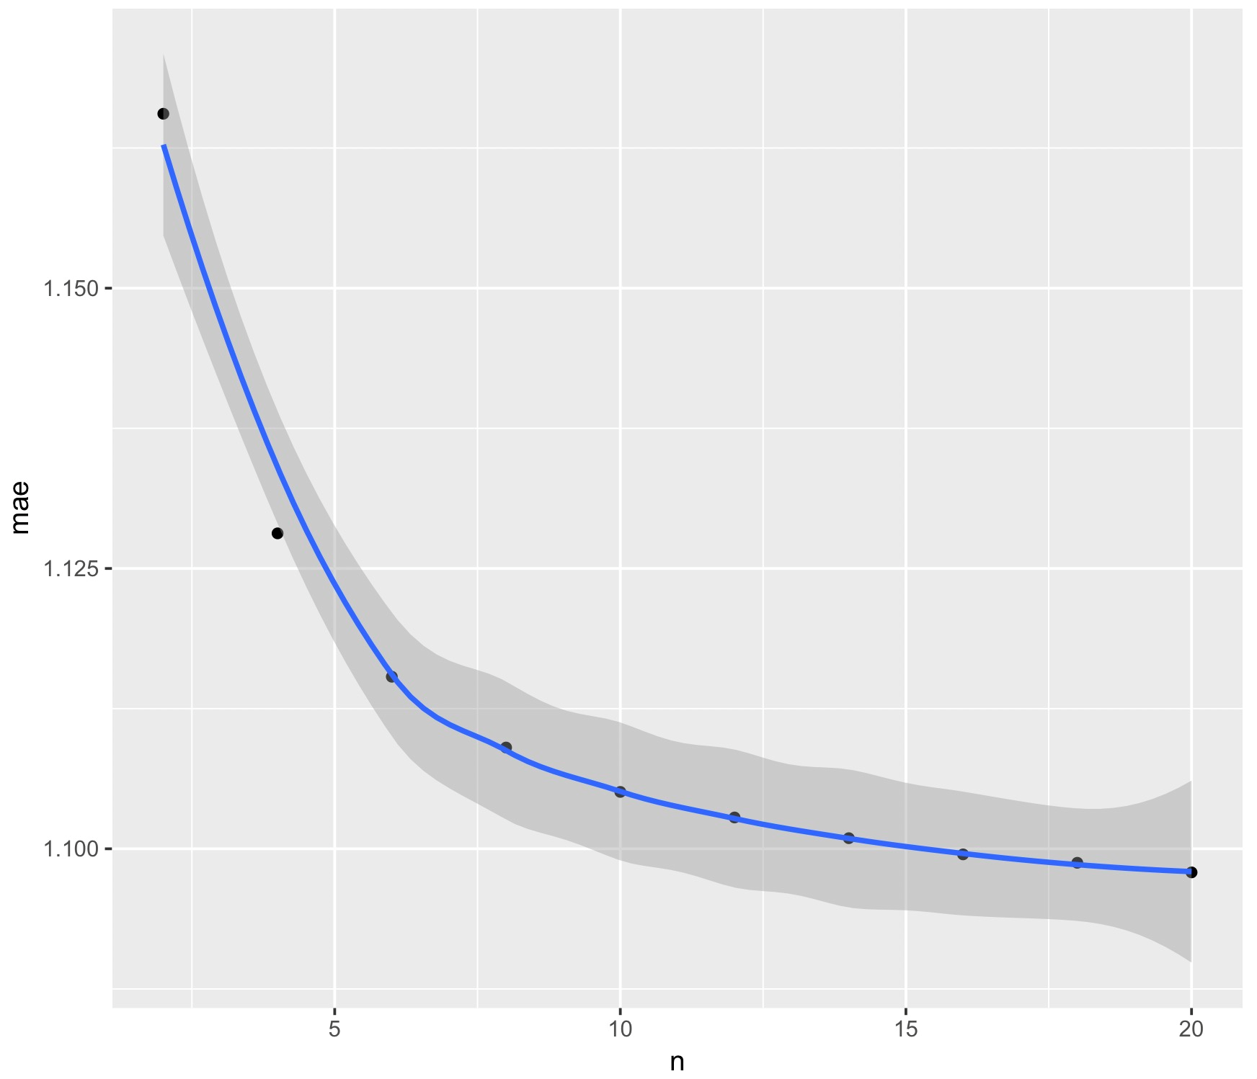
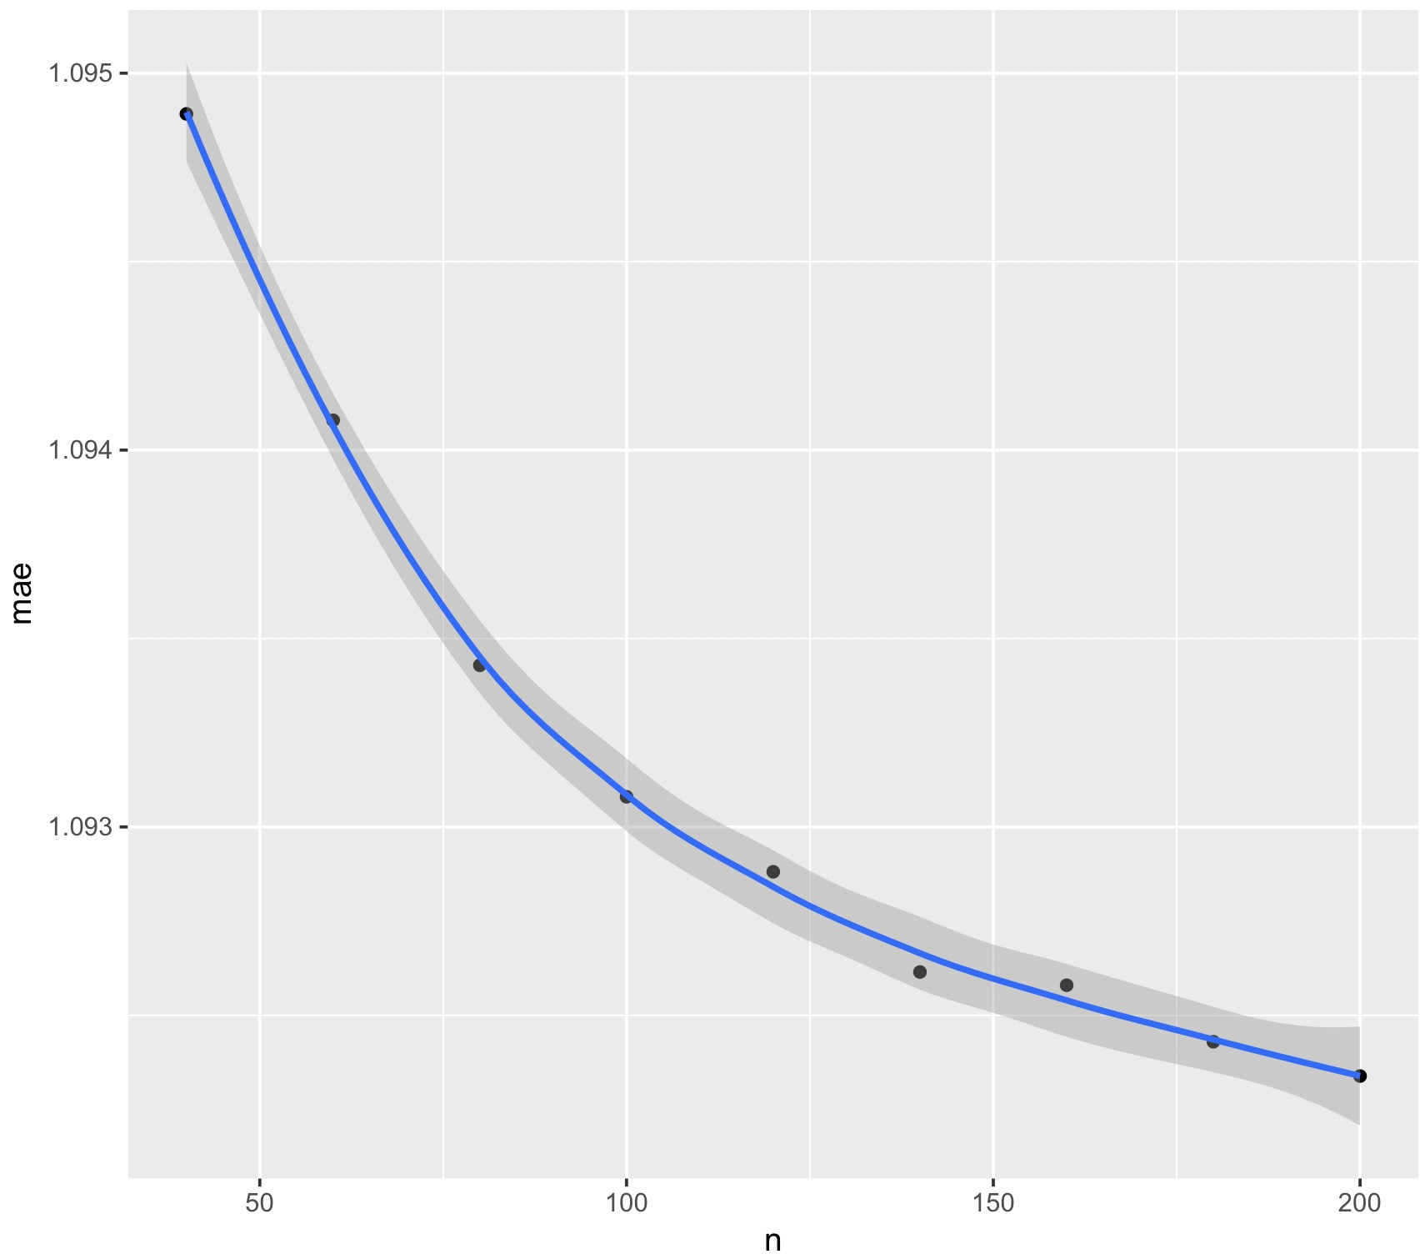
Parameter
For movie dataset, the MAE using the simrank with bestn

Slide 11
Parameter
For movie dataset, the MAE using
the vector vimilarity weight with bestn

Slide 12
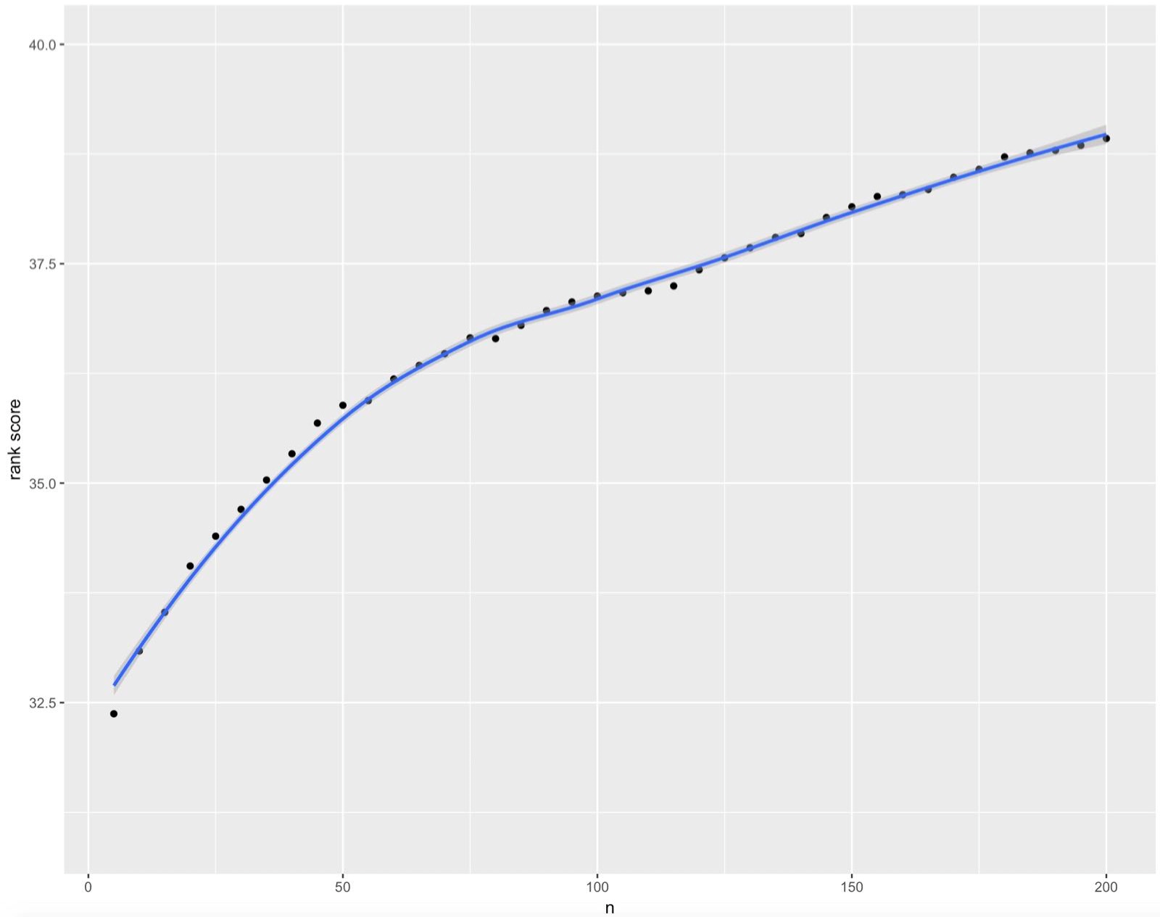
Parameter
For MS dataset, the rankscore using
the msd weight with bestn

Slide 13
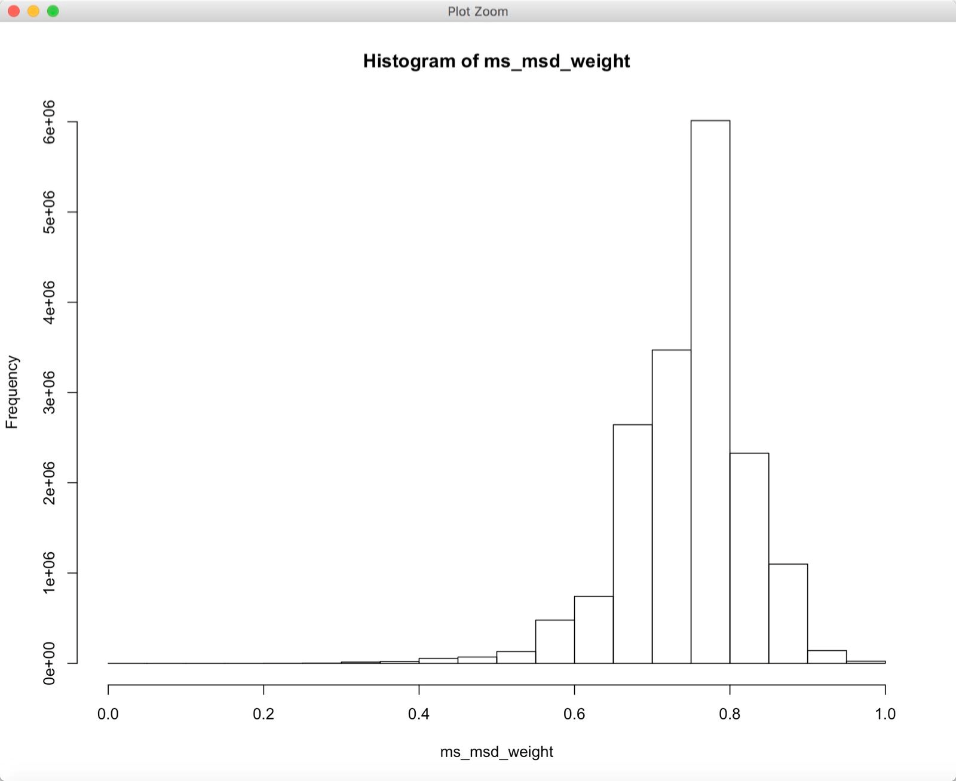
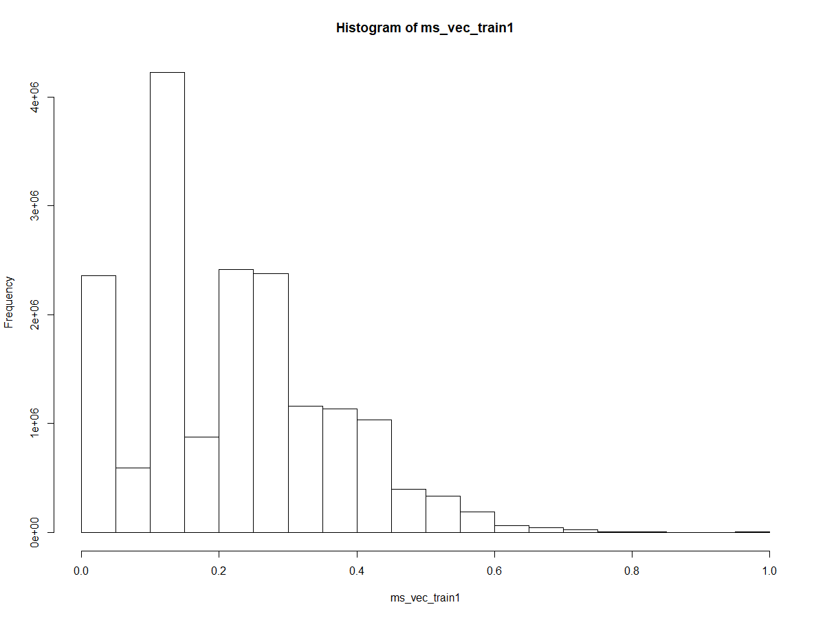
Parameter
The distribution of weights The distribution of msd weight

Slide 14
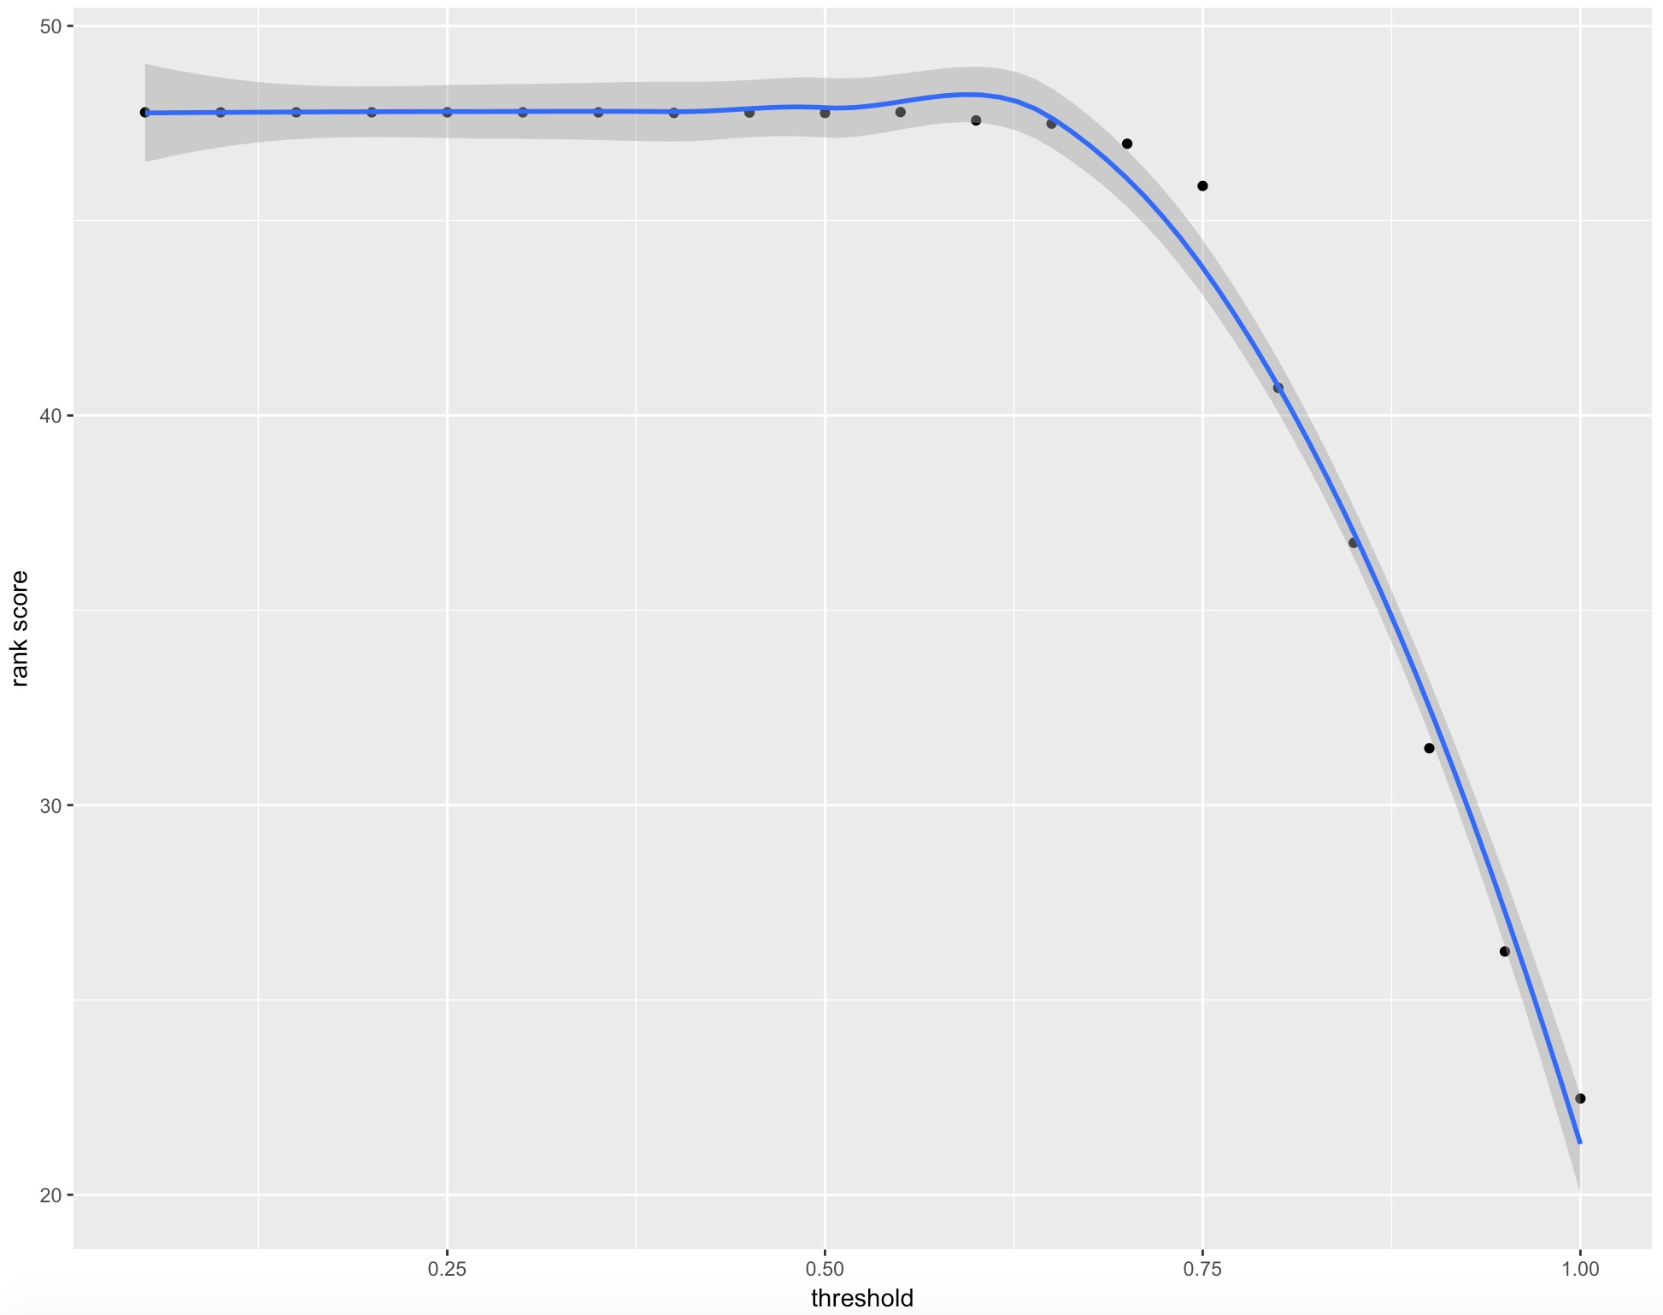
Parameter
For MS dataset, the rankscore using
the MSD weight with threshold

Slide 15
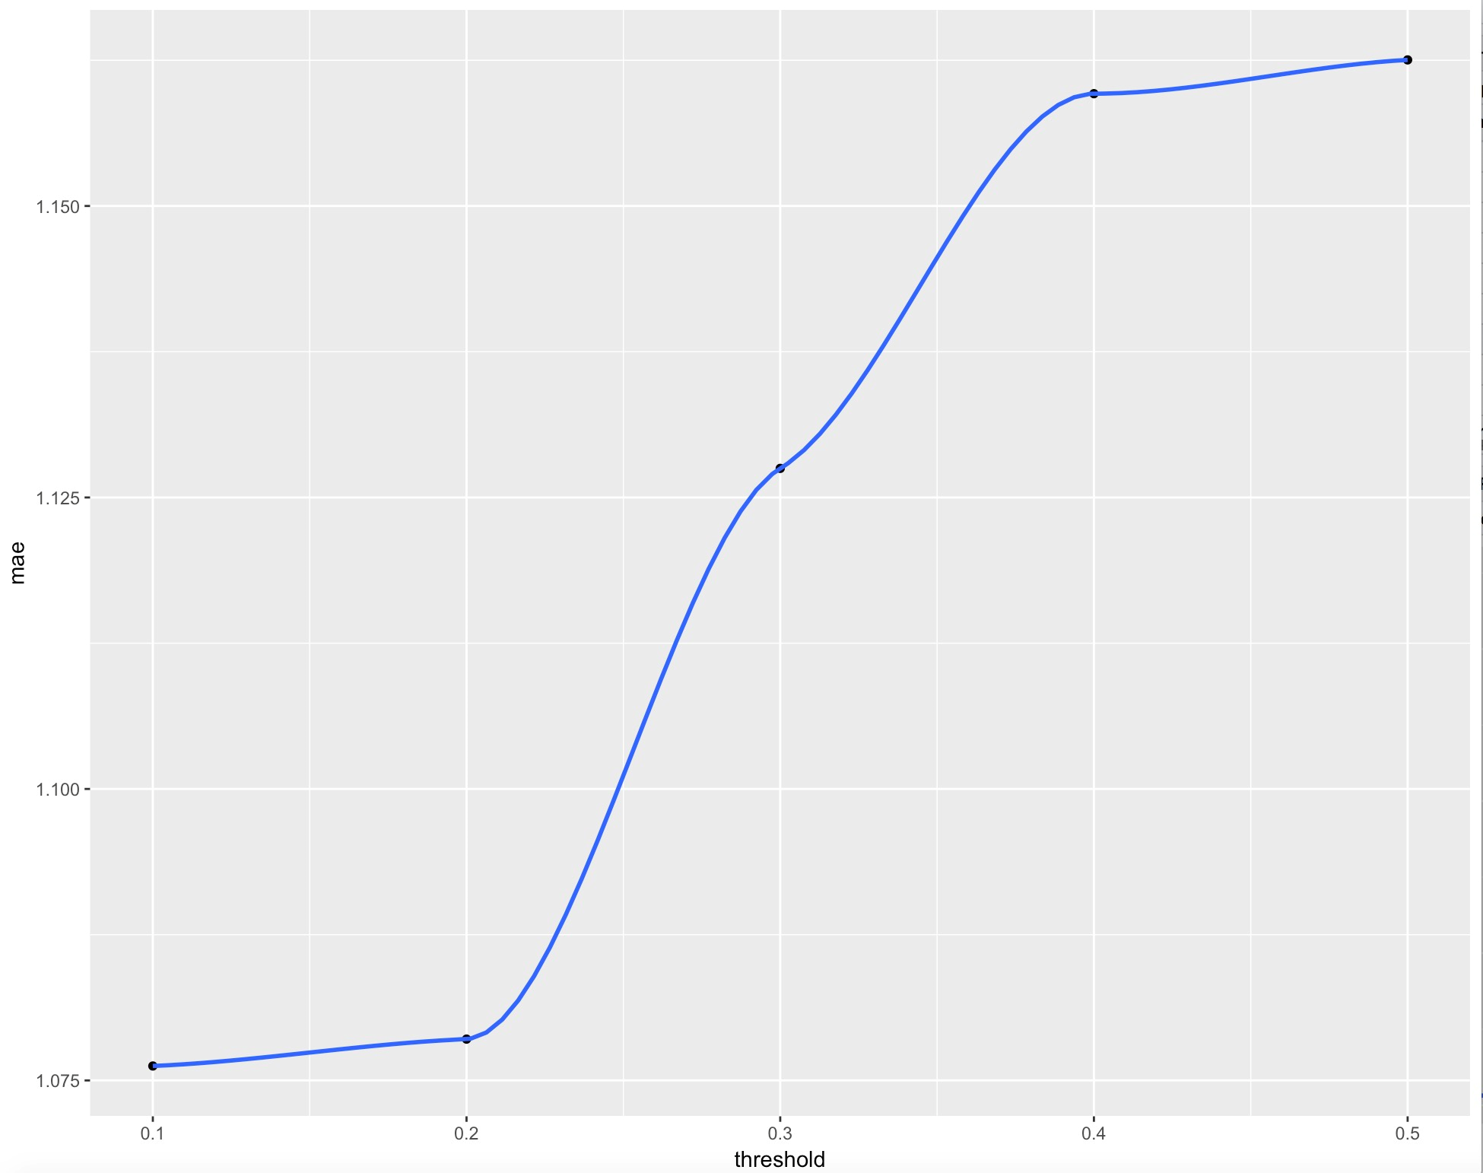
Parameter
For movie dataset, the MAE using
the vector similarity weight with threshold

Slide 16
Parameter conclusion
We can found that , as the N increase, the evaluation become better. The threshold increase,the evaluation become worse.
The reason: larger coverage of user increase the effectiveness of prediction.

Slide 17
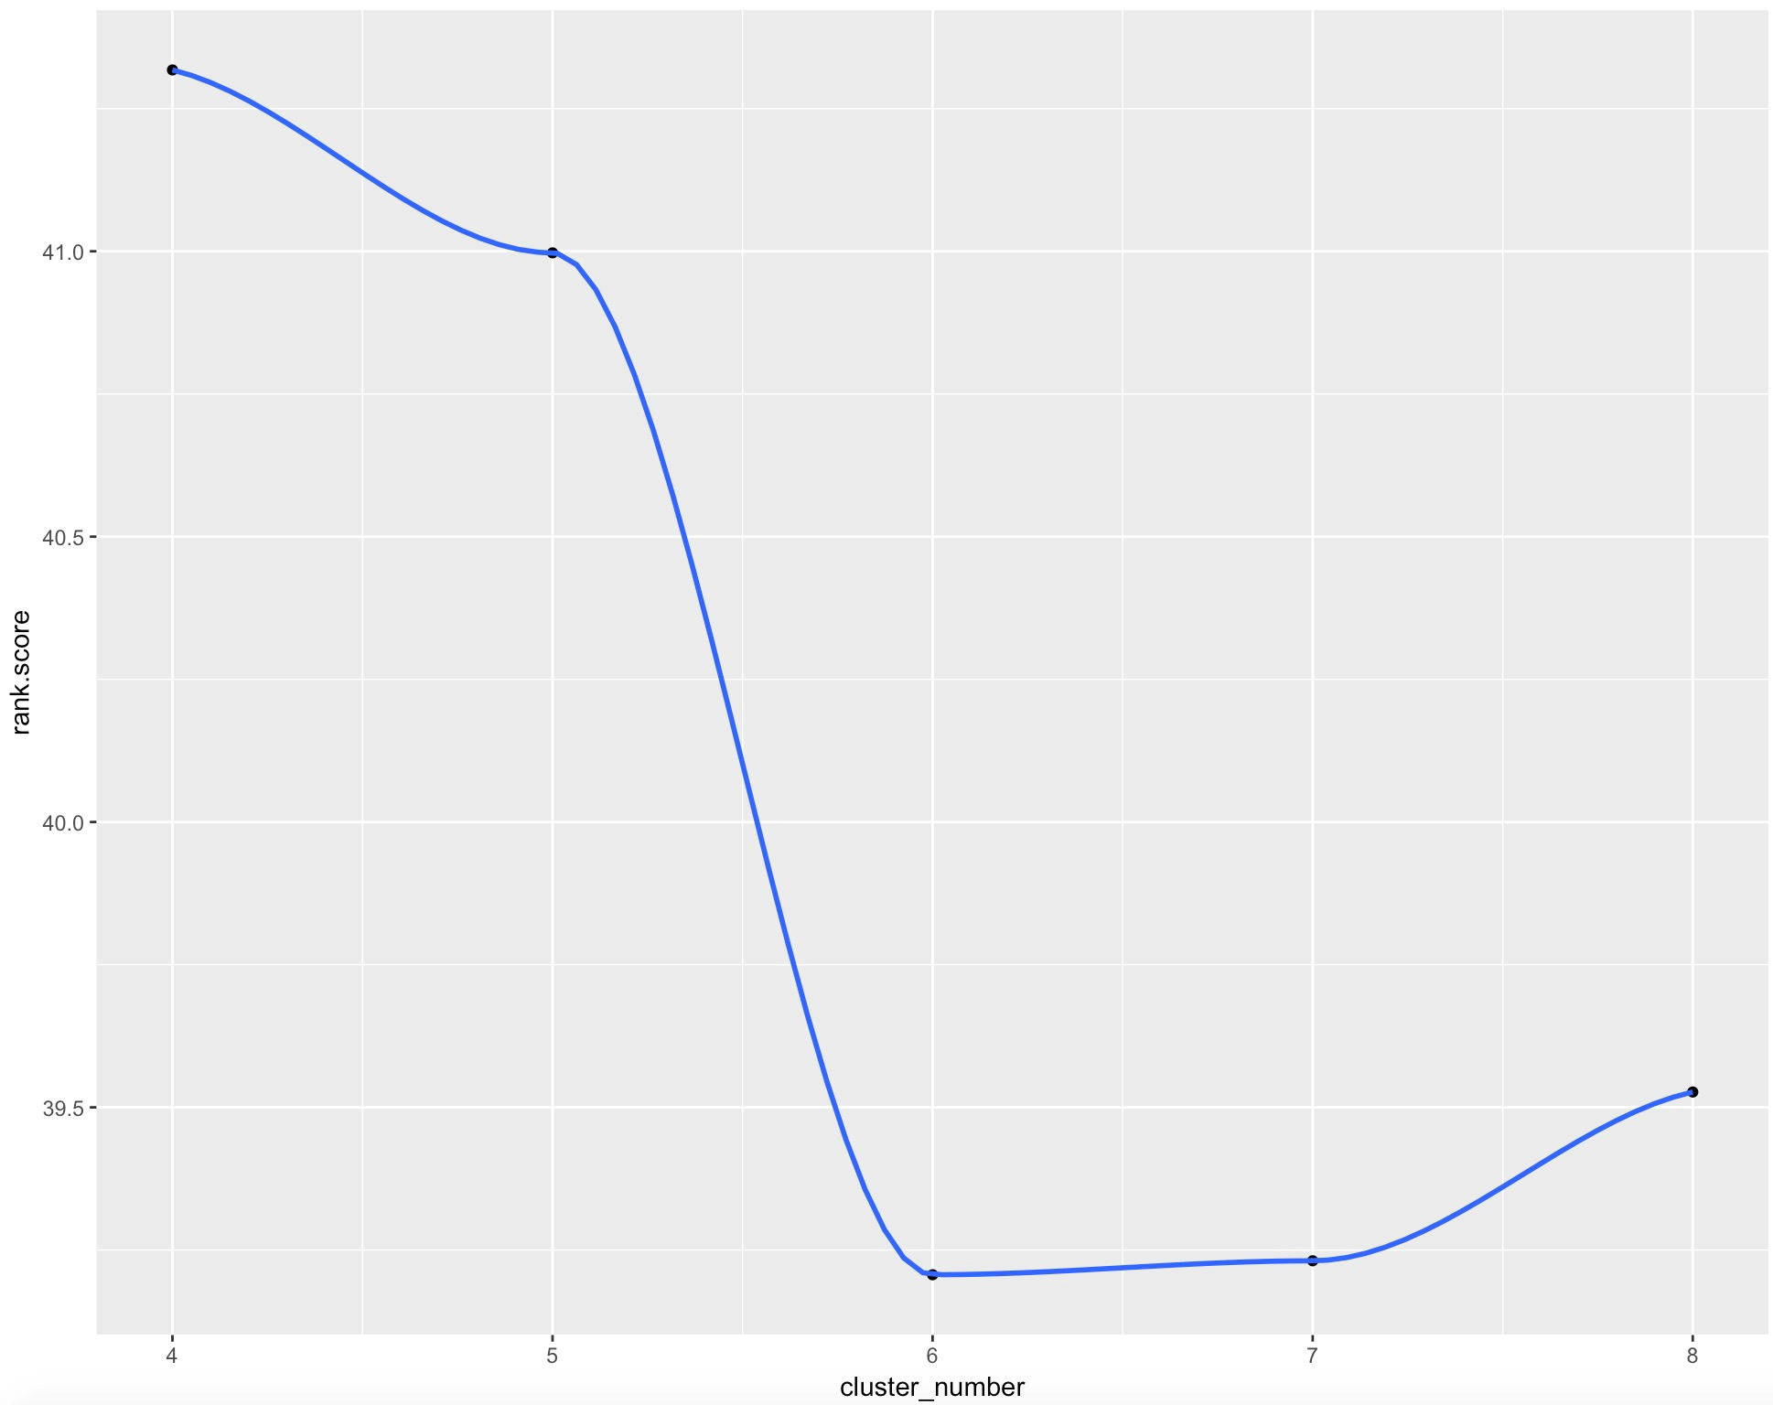
Parameter for cluster model
For MS dataset, the rankscore using
Cluster model with different C

Slide 18
Evaluation
Memory-based
1
Movie Data
 | vector | msd | simrank
best parameter | n=10 | n=60 | n=20
MAE | 1.03 | 0.96 | 1.08
For movie dataset, we use MAE to evaluate the effectiveness of prediction.

Slide 19
Evaluation
Memory-based
MS Data
 | vector | msd
best parameter | thres=0.1 | thres=0.6
ranked score | 45.9 | 47.5
1
Model-based
MS Data
 | cluster
best parameter | C=4
ranked score | 41.3
For MS dataset, we use Rankscore to evaluate the effectiveness of prediction.

Slide 20
Q&A

